Slide 1
Pneumonia Detection From Chest X-ray Images
Name | ID
Mohammad Arshadul Alam Rakib | 1731487042

Slide 2
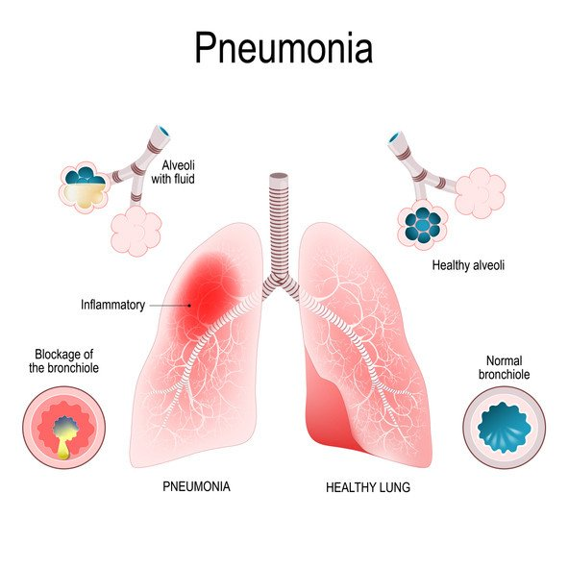
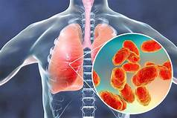
What is Pneumonia?
Pneumonia is an inflammatory disease affecting the air sacs of the lungs. Pneumonia generally caused by the bacteria, virus or real fungi present in the inhaled air. These germs may get lodged in the alveoli and result in an Infection leading pneumonia.

Slide 3
Project IDEA
Build a project using deep learning which can determine whether a person suffers from pneumonia or not from chest X-ray.
And if detect pneumonia then determine whether it’s caused by bacteria or virus.
Use CNN (Convolutional Neural Network) model to classify images according to features.

Slide 4
Dataset
Chest X-rays dataset(5863 Images): https://www.kaggle.com/paultimothymooney/chest-xray-pneumonia
Chest X-rays dataset(5840 Images):
https://www.kaggle.com/alifrahman/chestxraydataset

Slide 5
Expectation from Project
I will try to maximize the accuracy in recognizing whether a person is effected by pneumonia or not.
Will also try to detect the accuracy in recognizing is the effected person are effected by the virus or bacteria.

